Slide 1
Decoding List Mode Binary Data
George Netscher, Qiyu Peng

Slide 2
Data In
Status word
Event word
Single Event
Coincidence event
Raw ADC
32-bit
64-bit
32:32
32:64
64:64
64:128
Event data format / Timer
Single event rate
Coincidence event rate

Slide 3
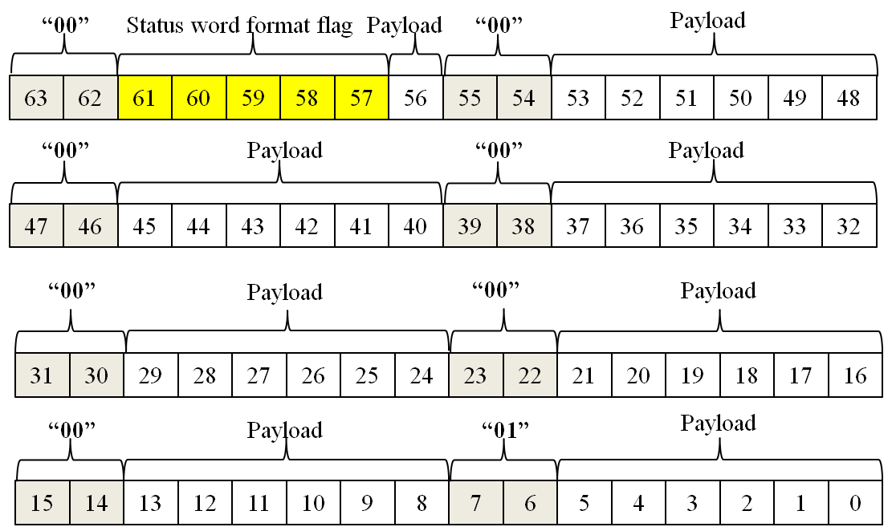
Status Words
Provide ancillary information
Format
64 bits marked by “00” beginning each byte
Last byte begins “01”
Format flag indicates type of word
Payload contains data
64-bit status word

Slide 4
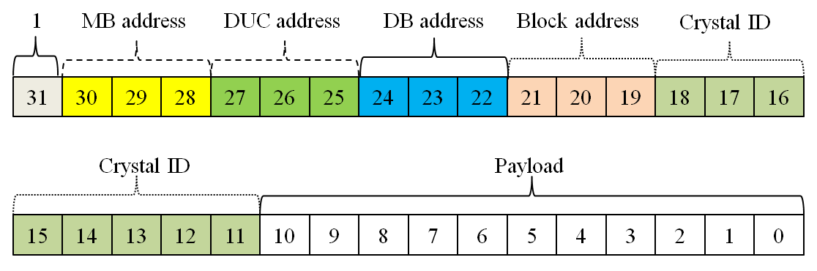
Event Words
Raw ADC
32 bits
Single event
32 or 64 bits
Coincidence event
32, 64, or 128 bits
Format
Most-significant bit always “1”
Ex. 32-bit single event word

Slide 5
Data In
Status word
Event word
Single Event
Coincidence event
Raw ADC
32-bit
64-bit
32:32
32:64
64:64
64:128
Event data format / Timer
Single event rate
Coincidence event rate

Slide 6
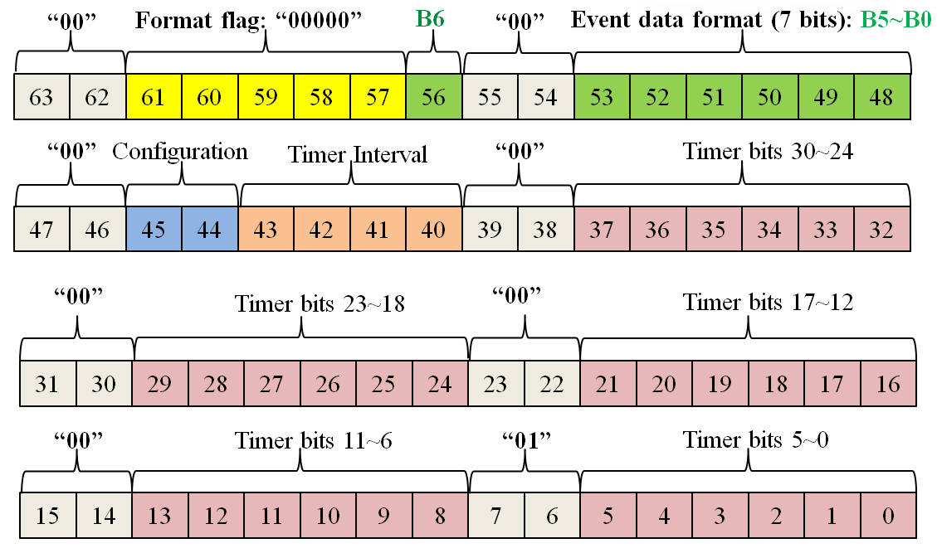
Status Word – Event data format / Timer
Bit 63-62, 55-55, 47-46, 39-38, 31-30, 23-22, 15-14: “00”
Bits 7-6: “01”
Bit 61-57: status word type – format/timer word = “00000”
Bit 56: single or coincidence
Bits 53-48: event word type (i.e. raw ADC)
Bits 45-44: system config (i.e. small config)
Bits 43-40: status word frequency (i.e. every 1 ms)
Remaining 30 bits: timer
Event data format / Timer word

Slide 7
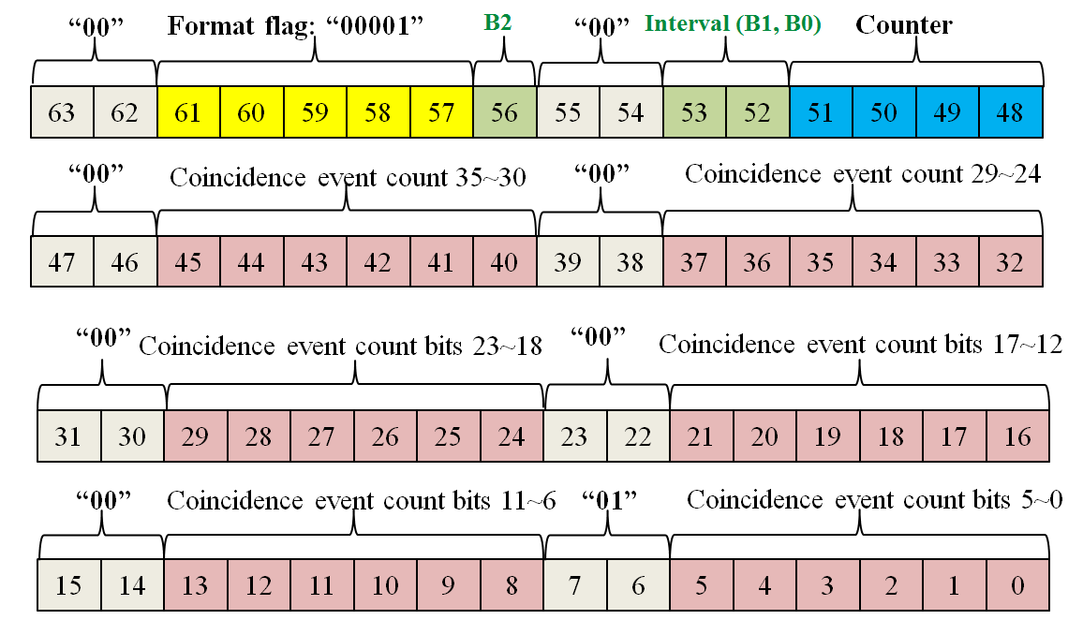
Status Word – Coincidence event rate
Bit 63-62, 55-55, 47-46, 39-38, 31-30, 23-22, 15-14: “00”
Bits 7-6: “01”
Bit 61-57: status word type – coincidence rate word = “00001”
Bit 56,53,52: status word frequency (i.e. every 1 sec)
Bits 51-48: coincidence event rate status word counter
Remaining 36 bits: coincidence event counter
Coincidence event rate word

Slide 8
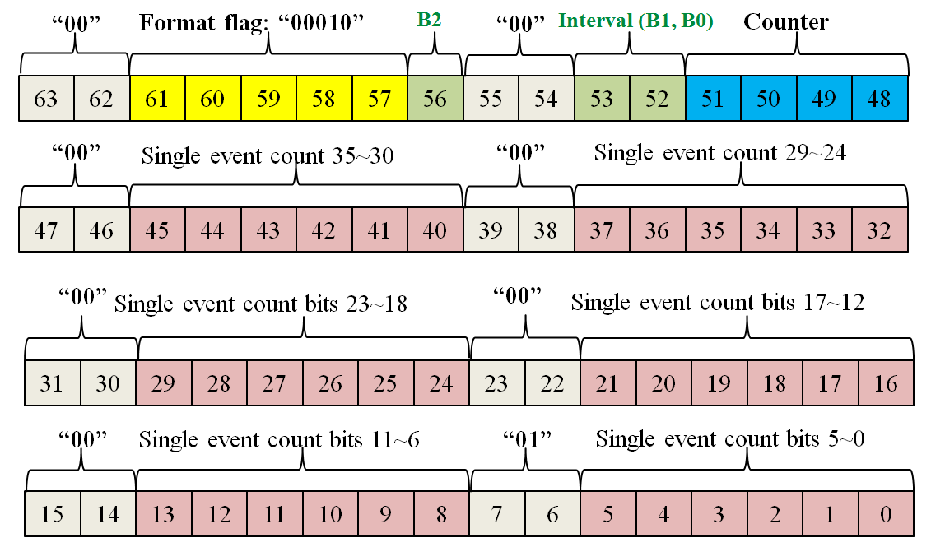
Status Word – Single event rate
Bit 63-62, 55-55, 47-46, 39-38, 31-30, 23-22, 15-14: “00”
Bits 7-6: “01”
Bit 61-57: status word type – single event rate word = “00010”
Bit 56,53,52: status word frequency (i.e. every 1 sec)
Bits 51-48: single event rate status word counter
Remaining 36 bits: single event counter
Single event rate word

Slide 9
Data In
Status word
Event word
Single Event
Coincidence event
Raw ADC
32-bit
64-bit
32:32
32:64
64:64
64:128
Event data format / Timer
Single event rate
Coincidence event rate

Slide 10
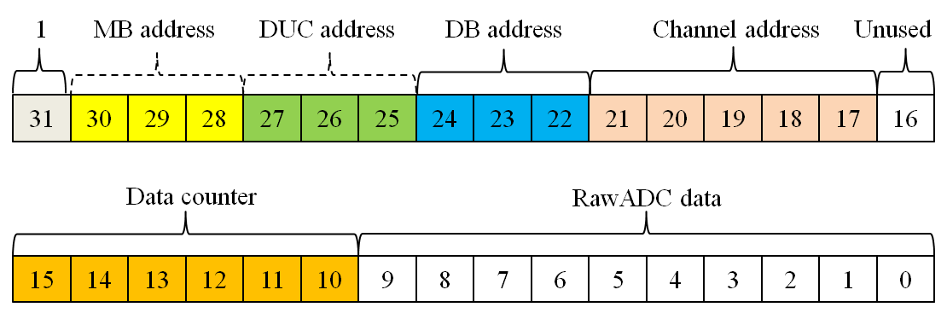
Single Event - Raw ADC
Bit 31: “1”
Bits 30-17: address
Bit 16: unused
Bits 15-10: 64-level counter to create ADC train
Bits 9-0: raw ADC data
32-bit raw ADC data
64 raw ADC data points form 1 single event curve

Slide 11
Single Event – 32-bit data
Bit 31: “1”
Bits 30-11: address
Bits 10-0: payload data
Time mode, energy mode, test mode, flood map mode, user-defined mode
32-bit single event data

Slide 12
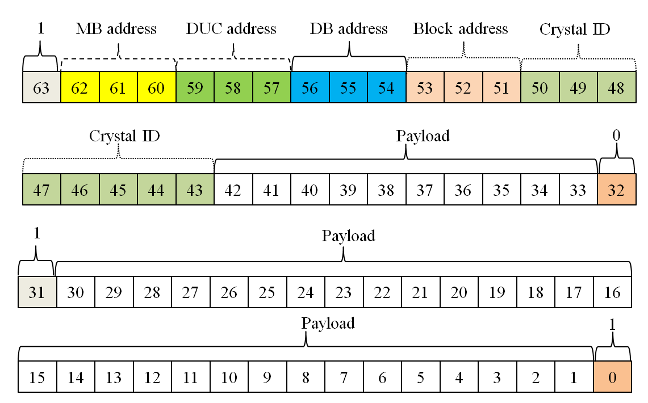
Single Event – 64-bit data (not recommended)
Bit 63: “1”
Bit 32: “0”
Bit 31: “1”
Bit 0: “1”
Bits 62-43: address
Bits 42-33,30-1: payload data
64-bit single event data

Slide 13
Data In
Status word
Event word
Single Event
Coincidence event
Raw ADC
32-bit
64-bit
32:32
32:64
64:64
64:128
Event data format / Timer
Single event rate
Coincidence event rate

Slide 14
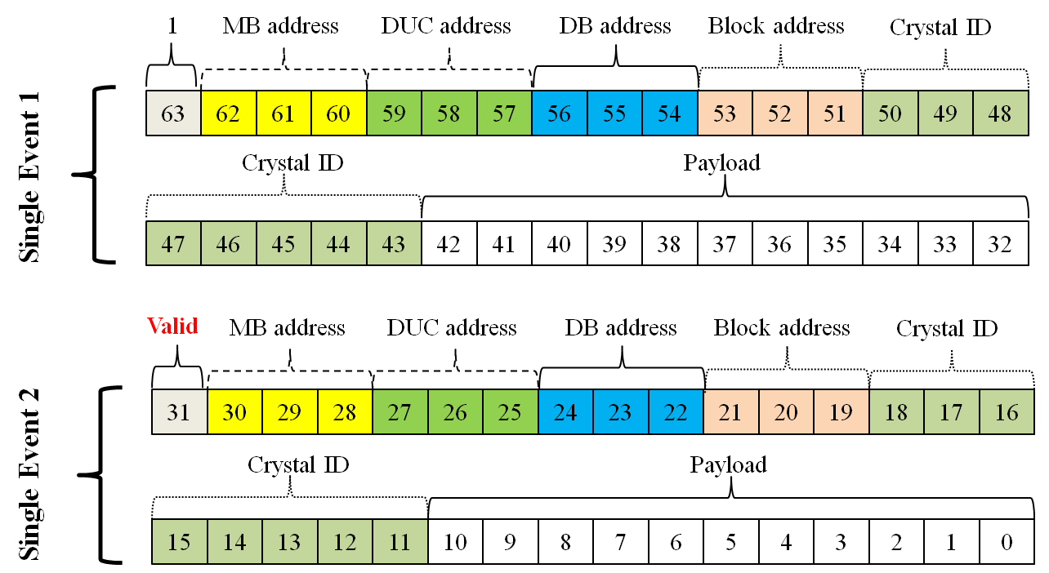
Coincidence event – 32-bit → 64-bit
Two 32-bit single event words
Bit 31: set to 1 if valid coincidence data; 0 if not
32→64-bit coincidence event data

Slide 15
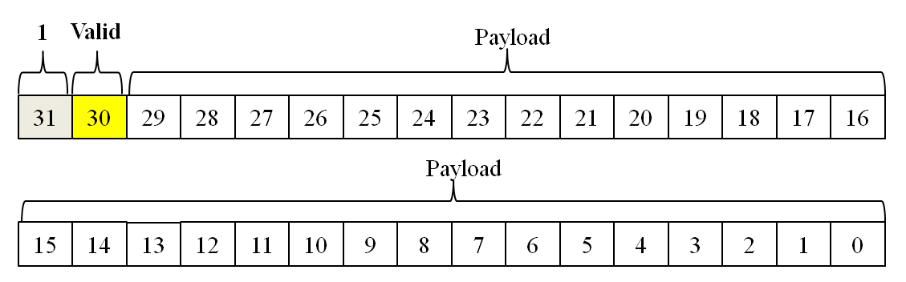
Coincidence event – 32-bit → 32-bit
Bit 31: “1”
Bit 30: set to 1 if valid coincidence data; 0 if not
Bits 29-0: determined by user (i.e. coincidence pair ID and time differential)
32→32-bit coincidence event data

Slide 16
Coincidence event – 64-bit → 128-bit
Two 64-bit single event words
Bit 63: set to 1 if valid coincidence data; 0 if not
64-bit single event data

Slide 17
Coincidence event – 64-bit → 64-bit
Bit 63: “1”
Bit 62: set to 1 if valid coincidence data; 0 if not
Bits 61-0: determined by user (i.e. coincidence pair ID and time differential)

Slide 18
Data In
Status word
Event word
Single Event
Coincidence event
Raw ADC
32-bit
64-bit
32:32
32:64
64:64
64:128
Event data format / Timer
Single event rate
Coincidence event rate

